Slide 1
Denver Eagle EMU Project
Electromagnetic Compatibility
Phase Shift Control for Propulsion Converter
2011. 11. 30
Hyundai Rotem Company
M.S. Kong

Slide 2
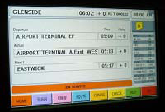

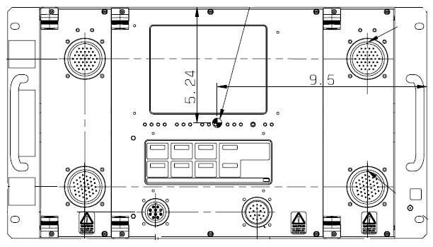
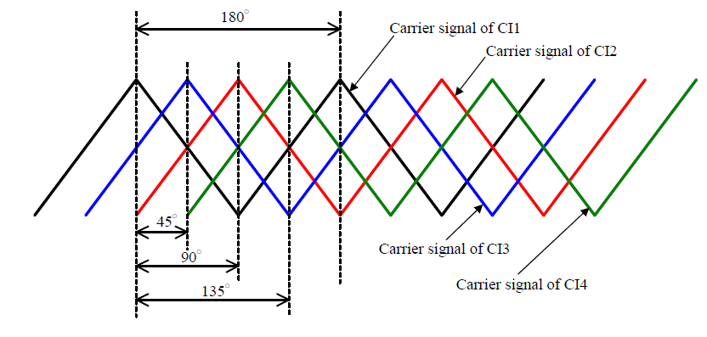
Denver Eagle EMU Project
      Phase Shift _ 2-cars
      - CRA(PA) – MDS – Converter/Inverter, (1) when START UP
      CCP (Comm. Control Panel)
      CCP (Comm. Control Panel)
      Information for car network
      (1) Train configuration info.(2 bits)
      00 ; 2-cars
      01 ; 4-cars
      10 ; 6-cars
      11 ; 8-cars
      (2) C/I position (8 bits = bit 3-10)
      10000000 ; no. 1 car
      RS 485
      RS 485
      CRA
      (Comm. Rack A)
      RS-485
      CRA
      (Comm. Rack A)
      RS-485
      Lonworks Network
      Lonworks Network
      MDS (CDT)
      MDS (CDT)
      Lonworks Network
      Lonworks Network
      Converter/Inverter
      Converter/Inverter
      Phase Shift (degree)
0
90
--
--
--
--
--
--

Slide 3
Denver Eagle EMU Project
      Phase Shift _ 2-cars
      - CRA(PA) – MDS – Converter/Inverter, (2) When a Converter/Inverter is Failed
      CCP (Comm. Control Panel)
      RS 485
      RS 485
      CRA
      (Comm. Rack A)
      RS-485
      CRA
      (Comm. Rack A)
      RS-485
      Lonworks Network
      Lonworks Network
      MDS (CDT)
      MDS (CDT)
      Lonworks Network
      Lonworks Network
Excessive Noise
FAILURE
      Converter/Inverter
      Converter/Inverter
      Information for car network
      Failure of Converter/Inverter
      10000000 ; no. 1 car fault
      Phase Shift (degree)
X
90
--
--
--
--
--
--

Slide 4
Denver Eagle EMU Project
      Phase Shift _ 4-cars
      - CRA(PA) – MDS – Converter/Inverter, (3) when START UP
      CCP (Comm. Control Panel)
      CCP (Comm. Control Panel)
      Information for car network
      (1) Train configuration info.(2 bits)
      00 ; 2-cars
      01 ; 4-cars
      10 ; 6-cars
      11 ; 8-cars
      (2) C/I position (8 bits = bit 3-10)
      00100000 ; no. 3 car
      RS 485
      RS 485
      RS-485
      CRA
      (Comm. Rack A)
      RS-485
      CRA
      (Comm. Rack A)
      RS-485
      RS-485
      Lonworks Network
      Lonworks Network
      MDS (CDT)
      MDS (CDT)
      Lonworks Network
      Lonworks Network
      Converter/Inverter
      Converter/Inverter
      Phase Shift (degree)
0
90
45
135
--
--
--
--

Slide 5
Denver Eagle EMU Project
      Phase Shift _ 4-cars
      - CRA(PA) – MDS – Converter/Inverter, (4) When a Converter/Inverter is Failed
      CCP (Comm. Control Panel)
      CCP (Comm. Control Panel)
      RS 485
      RS 485
      RS-485
      CRA
      (Comm. Rack A)
      RS-485
      CRA
      (Comm. Rack A)
      RS-485
      RS-485
      Lonworks Network
      Lonworks Network
      MDS (CDT)
      MDS (CDT)
      Lonworks Network
      Lonworks Network
      Converter/Inverter
      Converter/Inverter
      Information for car network
      Failure of Converter/Inverter
      00100000 ; no. 3 car fault
      Phase Shift (degree)
0
60
X
120
--
--
--
--

Slide 6
Denver Eagle EMU Project
      Phase Shift _ 6-cars
      - CRA(PA) – MDS – Converter/Inverter, (5) when START UP
      CCP (Comm. Control Panel)
      CCP (Comm. Control Panel)
      Information for car network
      (1) Train configuration info.(2 bits)
      00 ; 2-cars
      01 ; 4-cars
      10 ; 6-cars
      11 ; 8-cars
      (2) C/I position (8 bits = bit 3-10)
      00100000 ; no. 3 car
      RS 485
      RS 485
      RS-485
      CRA
      (Comm. Rack A)
      RS-485
      CRA
      (Comm. Rack A)
      RS-485
      RS-485
      Lonworks Network
      Lonworks Network
      MDS (CDT)
      MDS (CDT)
      Lonworks Network
      Lonworks Network
      Converter/Inverter
      Converter/Inverter
      Phase Shift (degree)
0
45
90
135
0
90
--
--

Slide 7
Denver Eagle EMU Project
      Phase Shift _ 6-cars
      - CRA(PA) – MDS – Converter/Inverter, (6) When a Converter/Inverter is Failed
      CCP (Comm. Control Panel)
      CCP (Comm. Control Panel)
      RS 485
      RS 485
      RS-485
      CRA
      (Comm. Rack A)
      RS-485
      CRA
      (Comm. Rack A)
      RS-485
      RS-485
      Lonworks Network
      Lonworks Network
      MDS (CDT)
      MDS (CDT)
      Lonworks Network
      Lonworks Network
      Converter/Inverter
      Converter/Inverter
      Information for car network
      Failure of Converter/Inverter
      00100000 ; no. 3 car fault
      Phase Shift (degree)
0
60
X
120
0
90
--
--

Slide 8
Denver Eagle EMU Project
      Phase Shift _ 8-cars
      - CRA(PA) – MDS – Converter/Inverter, (7) when START UP
      CCP (Comm. Control Panel)
      CCP (Comm. Control Panel)
      Information for car network
      (1) Train configuration info.(2 bits)
      00 ; 2-cars
      01 ; 4-cars
      10 ; 6-cars
      11 ; 8-cars
      (2) C/I position (8 bits = bit 3-10)
      00100000 ; no. 3 car
      RS 485
      RS 485
      RS-485
      CRA
      (Comm. Rack A)
      RS-485
      CRA
      (Comm. Rack A)
      RS-485
      RS-485
      Lonworks Network
      Lonworks Network
      MDS (CDT)
      MDS (CDT)
      Lonworks Network
      Lonworks Network
      Converter/Inverter
      Converter/Inverter
      Phase Shift (degree)
0
90
45
135
0
90
45
135

Slide 9
Denver Eagle EMU Project
      Phase Shift _ 8-cars
      - CRA(PA) – MDS – Converter/Inverter, (8) When a Converter/Inverter is Failed
      CCP (Comm. Control Panel)
      CCP (Comm. Control Panel)
      RS 485
      RS 485
      RS-485
      CRA
      (Comm. Rack A)
      RS-485
      CRA
      (Comm. Rack A)
      RS-485
      RS-485
      Lonworks Network
      Lonworks Network
      MDS (CDT)
      MDS (CDT)
      Lonworks Network
      Lonworks Network
      Converter/Inverter
      Converter/Inverter
      Information for car network
      Failure of Converter/Inverter
      00100000 ; no. 3 car fault
      Phase Shift (degree)
0
60
X
120
0
90
45
135

